Slide 1
Presents
OO Programming with Java
Java Language Fundamentals
Flow of Control
Notes:
Object-Oriented Programming with Java
Java Language Fundamentals – Flow of Control
Module 3

Slide 2
Learning Objectives
Become familiar with the Java language syntax
Understand the built-in operators
Write simple Java expressions
Understand branching (if, case) and looping (for, while) statements
Notes:
In this chapter we set aside object-oriented concepts to examine the mechanics of writing Java statements.

Slide 3
Java Operators
Next we’ll see how to perform mathematical and logical operations in Java
The syntax is straight forward and much of it may already be familiar to you
We will also examine the dot operator – probably the most common operator in Java

Slide 4
Java’s Operators
Assignment operator: =
Mathematical operators: + – * / %
Unary increment or decrement: ++ ––
Relational operators : < == > <= >= !=
Logical operators: && || !
Logical and Bitwise operators: & | ~ ^ << >> >>>
The dot operator is used to access attributes and methods within a specific instance of a class
Notes:
In C++ operators may be overloaded. Java does not allow this except in the special case of the ‘+’ operator which is used for string concatenation. More on string concatenation later.

Slide 5
Assignment Operator
int i, j;
i = 42; // i takes the value 42
j = 21; // j takes the value 21
i = 21; // old value overwritten
i = i + j; // i takes the value 42
Notes:
The addition operator has a higher precedence than the assignment operator. In the line "i = i + j;”, the addition is resolved first and then the assignment is made.

Slide 6
Mathematical Operators
Java’s mathematical operators are fairly standard
  + Addition
  - Subtraction
  * Multiplication
  / Division
  % Modulus (for whole numbers only)
There are also unary versions of + and –
Precedence of binary operators is:
  multiply, divide & modulo
  add and subtract
Notes:
Review the following table and make sure that you agree with all the answers.
The + operator is overloaded and is also used for String concatenation.

Slide 7
Unary Operators
Java has prefix and postfix increment and decrement operators:
  prefix increment (++i) increments i by 1 and then uses it in the expression
  prefix decrement (--i) decrements i by 1 and then uses it in the expression
  postfix increment (i++) uses i in the expression and then increments it by 1
  postfix decrement (i--) uses i in the expression and then decrements it by 1
Notes:
int i = 10;
int j = ++i; // j and i are both 11
int k = j + --i ; // k is 21 and i is 10
--i; // i is now 9
int i = 10;
int j = i++; // j is 10 but i is 11
int k = j + i-- ; // k is 21 and i is 10
i++; // i is 11

Slide 8
Relational Operators
Java has the following relational operators:
a < b a is less than b
a <= b a is less than or equal to b
a == b a is equal to b
a != b a is not equal to b
a >= b a is greater than or equal to b
a > b a is greater than b
These operators result in a boolean value (true/false) which is normally used in branching or looping statements

Slide 9
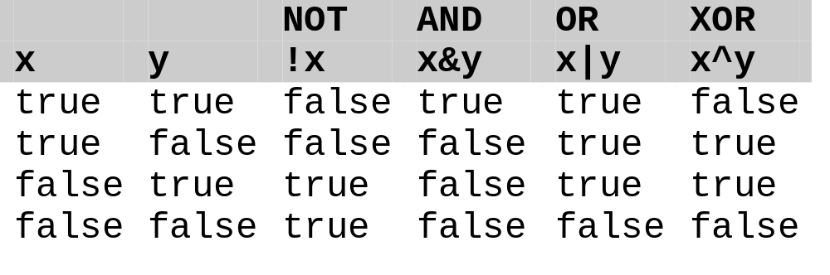
Boolean Operators
&& and || are short circuit operators
& and | do not short circuit
& | ^ applied to integral variables are performed bitwise
Notes:
boolean b1 = false, b2 = false, b3 = false, b4 = false;
boolean truth = true;
b1 = (6 == 3) && (5 < 8); // false
b2 = truth || b1; // true
b3 = b1 ^ b2; // true
b4 = b1 | b2 & b3; // true
The short circuit version of the operator is the one that you would most often use. It is essential in circumstances where the evaluation of the second condition should only be made if the first condition has already evaluated to true.
if (foodMixerStopped && mixtureIsHandHot) …

Slide 10
Boolean Operator Examples
The boolean operators can be used to combine relational expressions. For example:
int x=7;
int y=9;
if ( x < 8 && y < 10 ){ // The expression is true
//code
}
boolean b = x < 8 || y < 3; // b is true

Slide 11
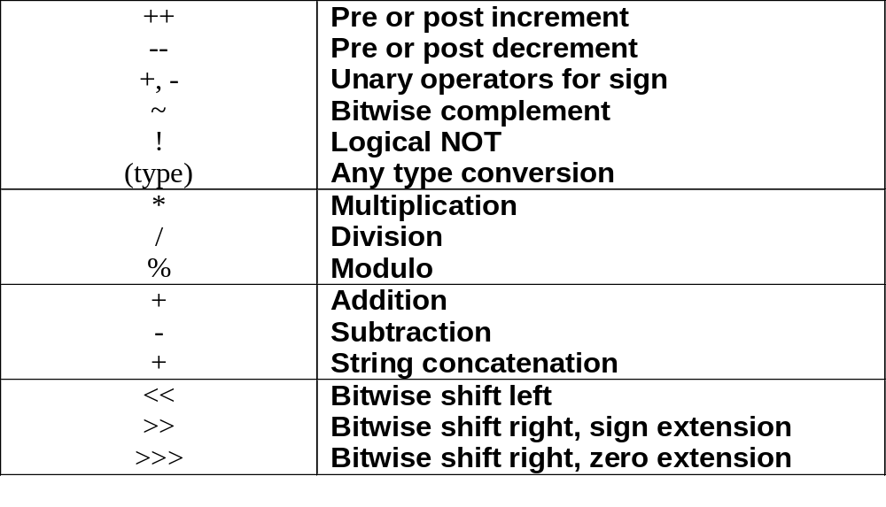
Operator Precedence
(continued on next slide)
Notes:
Operator Precedence

Slide 12
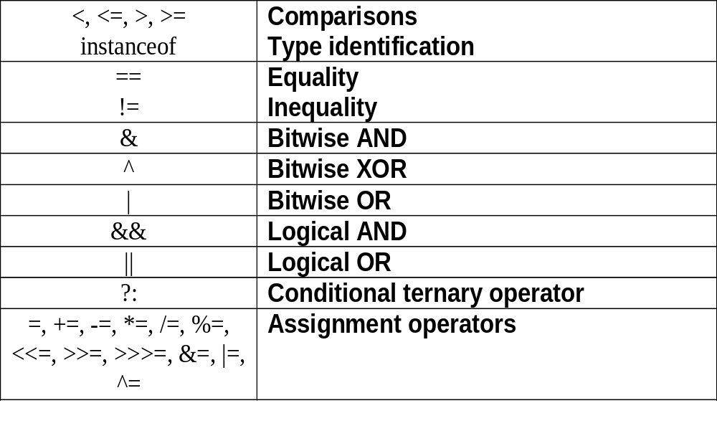
Operator Precedence
These tables show the order in which Java will evaluate operators it finds in each expression

Slide 13
Branching and Looping
The next section of this chapter covers:
  branching via the if and case statements
  looping with while, for, and enhanced for
This section assumes that you have seen these concepts in other languages. If this is inaccurate please ask your instructor to review in more detail.

Slide 14

Branching: The if Statement
The if statement works with the relational operators to execute a block of code only if some condition is true
Notes:
On its own, an if Statement acts as a kind of guarded expression. A conditional expression is evaluated (the guard condition) and if it evaluates to true the following statement is executed. If it evaluates to false the following single statement is skipped and execution continues after the statement. The conditional expression is always enclosed in parentheses.

Slide 15
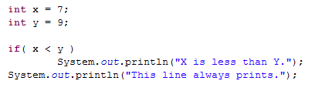
Single Statement Code Blocks
If you only want to execute one statement when your if condition is true, you do not need to use the braces (however, it is best practice to always include)

Slide 16

The if else Statement
You can also set up a block of code that will execute only when the comparison is false:
Like the if code block, the else code block can be a set of statements inside braces or a single statement as shown here.
Notes:
The if/else statement is used when there is a binary choice of code to execute. The guard condition is evaluated and if true, the first statement/block is executed and if false, the second statement/block is executed.
As with the previous if statement it is preferable to show the block braces even when they are unnecessary.
if( sharePrice < currentOffer )
{
System.out.println(“Buy, buy, buy!”);
}
else
{
System.out.println(“Sell, sell, sell!”);
}

Slide 17
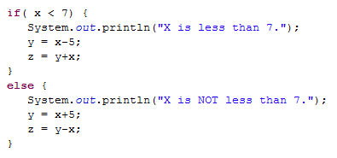
Multi-line Else Block
Notice the use of braces as well as the indentation in order to make the code more readable

Slide 18
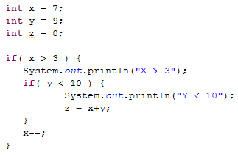
Nested ifs
You can place an if statement inside an if or else code block
The source code becomes more difficult to read
Indentation helps with readability

Slide 19
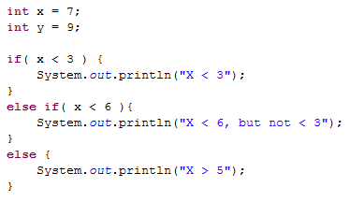
Multiple ifs – the else if
An else can also include an if
Notes:
There is no elseIf keyword as in some other languages.

Slide 20
Ternary Expressions
Ternary expressions produce a value based on the truth of the expression
int y = ( x > 7 )? 2 : 5;
( condition ) ? True value : false value;
  Ternaries short circuit.
If x is greater than 7, y will be set to 2, otherwise y will be set to 5
This is not an if statement – it is an expression that evaluates to a value.

Slide 21
switch Statement
An alternative to complex nested if statements is the switch statement.
Its general form is shown to the right. An example appears on the next slide
switch (<integral expression>) {
case label₁:
<statement₁>
case label₂:
<statement₂>
case label_{n}:
<statement_{n}>
default:
<statement>
}
Notes:
A switch statement is used to select among several alternatives.
It differs from nested-ifs in that it does not use Boolean values to make the decisions. Instead it decides which course of action to take based on the value of any integral type.
The selector value is compared with each label in turn and as soon as it finds a match it executes the statements that follow. This means that the selector value and the labels must be of the same type e.g., int or char.
Labels are unique single values and you cannot have a range of values. If this is what you need then you must return to nested-ifs.
The default case gets executed if there is no other match. It is optional.

Slide 22
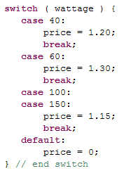
switch Example
break statement to
terminate the switch
deliberate ‘fall through’
to repeat code for different
case values
optional catch-all
Notes:
Warning: The switch statement allows execution to fall through from one label to the next unless you, the programmer, use a break statement to end the casse statement.

Slide 23
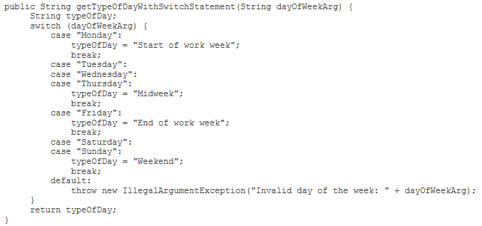
Java Programming Language Updates
Strings in switch statements
    In the JDK 7 release, you can use a String reference as a case value in a switch statement:

Slide 24
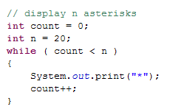
while Statement
The while statement executes a code block over and over again. As long as the test condition remains true the code block will keep repeating
If we remove the count++;
statement, this loop will never stop running.
If we set count to 20 before the while statement the while block will not run at all
Notes:
The while loop is used to repeat blocks of code for as long as a certain condition holds true. If the condition is never true then the code is never executed.
The code to be executed can be a single statement but is usually a block. The previous comments about using the block braces as a matter of policy hold true for while statements as well. You need to avoid trailing semicolons after the condition as in the if statement. The following code will always produce a single asterisk regardless of the value of n as the block will be executed only once:
while (asteriskCount < n);
{
System.out.print("*”);
asteriskCount++;
}
System.out.println();

Slide 25
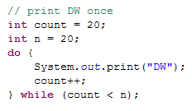
do while Statement
The do while provides a loop that will always run at least once. The test isn’t performed until the end of the while block
Notes:
Warning: The other common mistake with this construct is to forget to update the condition somewhere in the loop, creating an endless loop!
The purpose of the do-while is to ensure that the body of code is always executed at least once.

Slide 26
for Statement
The for statement was created to help prevent loops which never stop running due to coding errors. Its signature takes three expressions which are separated by semi-colons. Note: the semicolons are required – the expressions are optional.
for(int i=0; i<10; i++) {
// Code in the block
}
Initialize
Test
Post Block
This loop will run as long as i is less than 10. It will set i to 0 before it runs the code block for the first time. At the end of each pass through the block, it will increment i and re-test
Notes:
The for loop is used for circumstances where you know that you require a given number of actions to be performed. The syntax of the for loop helps prevent errors of omission as well as allowing the declaration of local counter variables in a convenient manner.
A loop forever is often written as for( ; ; )

Slide 27
Multiple Initializes for Example
The Initialize and Increment parts of the for signature can have more than one statement. Just separate them with commas.
int i, j;
for(i=0, j=2; i<10; i++, j+=3) {
// i increments by 1, j by 3
}

Slide 28
Enhanced for Statement
The basic for loop was extended in Java 5 to make it easier to loop through arrays and other types of “collections”.
This form is called a “for-each loop”.
  The for loop block is invoked “for each” element in the collection.
  Anything that implements the Iterable interface may be used in this kind of a loop.
  // general form of the loop:
  for( type name : collection) {
  // invoke methods of name
  }
Notes:
The for-each construct makes code simpler and easier to understand. Some situations preclude its use as shown in a following slide.
We will talk about what it means to “implement an interface” later in the course.

Slide 29
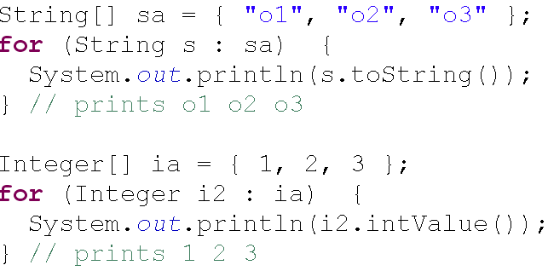
Enhanced for Example Code
The code for looping through different types of collection classes is the same.
  The compiler is responsible for generating the correct “standard” code to implement the loop.
  This code loops through two arrays of different types.
Notes:
As long as the container class correctly implements the methods of the Iterable interface, the use of the for-each loop is the same between classes.

Slide 30
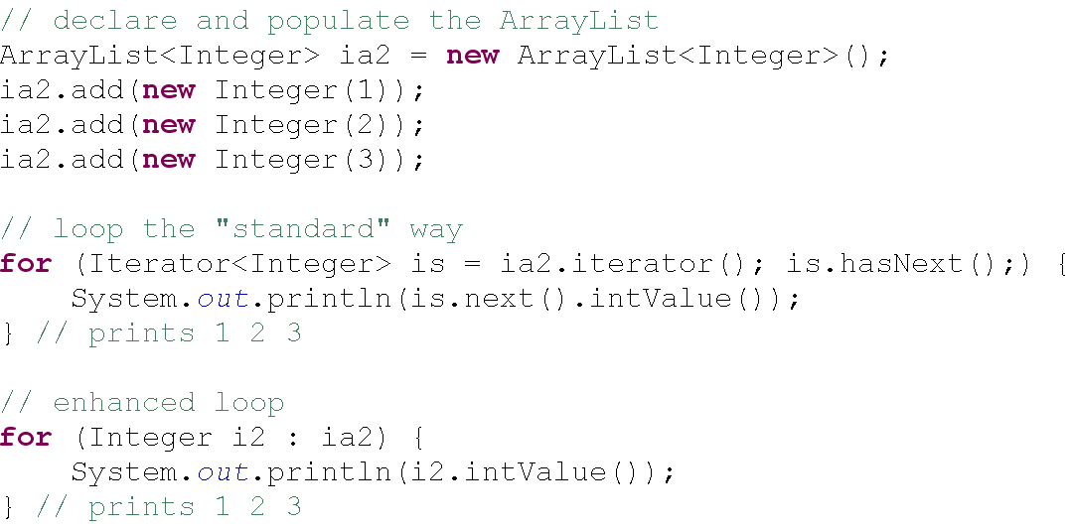
Standard for Loop Equivalent
“Standard” format is verbose and prone to mistakes.
Notes:
A frequent cause of bugs in standard loops is an extra next method invocation inserted in the body of the loop by mistake. If your application is processing every other element in the collection, this is usually the cause.
The next method always advances the pointer to the current element of the collection and returns it. This is the expected behavior for the next method in a number of classes in Java.

Slide 31
Enhanced for Loop Notes
Only access. Elements may be “read” and manipulated, but not safely added or removed from a collection.
Only single structure. It's not possible to loop through two collections at once.
Only single element. Useful only for single element access.
  Only one element is ever “visible” at a time.
Only forward. You may only loop forward by single steps.
Notes:
Note there are a number of possible enhancements to improve performance of loops using the for-each construct. Search for the following blog entry for a good article on for-each loop use and optimization:
Nuances of the Java 5.0 for-each Loop
Tue, 2006-11-07
Nishanth Sastry

Slide 32
break
The break statement when executed in a while, for, do-while or switch structure causes an immediate exit from that structure:
int count = -1;
while( count++ <= endValue )
int someVar = readData();
if( someVar == badValue ){
break;
}
System.out.println( count );
}

Slide 33
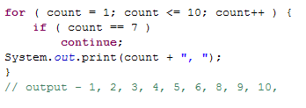
continue
The continue statement when executed in the body of a while, for or do-while structure skips the remaining statements and begins the next iteration:

